Slide 1

DATA SCIENCE CONSULTING
Session-1
Guillaume d'Hérouville
Kaan Caylan
Amjad Rehan Ibrahim
Thomas Schnieder
Shihan Ye
Harshit Shangari

Slide 2
Market trends leading to a higher churn rate
Increasing competition:
Increased supplier options may lead to lower prices and higher churn
rates
Deregulation:
Reduction in government regulations may open doors for new market
players
Economic downturns:
Recessions can impact demand for energy and affect industries
Technological advances:
Smart grids and digital platforms can make it easier for
customers to change suppliers
Sustainability concerns:
Cost-competitive green energy solutions may lead to more
customers switching to green energy suppliers.
Sources:
Market research and analysis, industry reports and publications.

Slide 3
Price Comparison
Methodology:
Assumptions: Standard household consumption
Method: Average prices comparison of top 5 energy suppliers in France.*
Characteristics: Price
Why price benchmark:
Important factor in consumer decision-making
Understand competitive pricing
Cost savings for consumers
Encourages suppliers to maintain competitive pricing
Promotes efficient market
Sources:
https://www.fournisseurs-electricite.com/en/edf
https://www.fournisseurs-electricite.com/en/engie .
*Data for ENI was not found even after intensive research

Slide 4
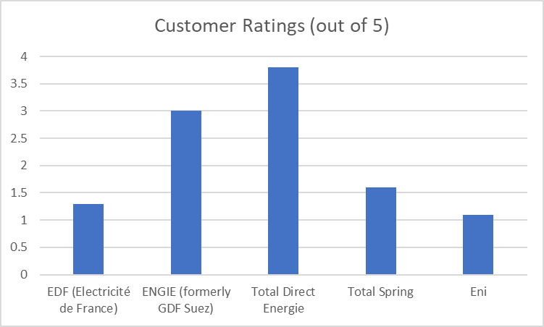
Customer Service
Methodology:
Assumptions: Standard households consumption
Characteristics: Reliability & Quality of customer service
Method: Comparison of customer service offered by top 5
Why customer service benchmark:
Important factor in consumer decision-making
Helps resolve issues quickly & efficiently
Identifies best service & customer support providers
Source:
https://fr.trustpilot.com/review/totalenergies.fr
https://fr.trustpilot.com/review/engie.fr
https://fr.trustpilot.com/review/edf.fr
https://fr.trustpilot.com/review/total-spring.fr
https://fr.trustpilot.com/review/eni.fr

Slide 5
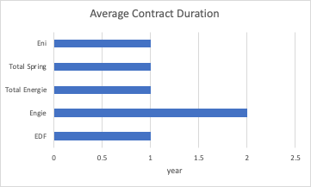
Contract Duration Comparison
Methodology:
Assumptions: Standard households consumption
Method: Average contract duration and termination fees of top 5 energy suppliers in France
Characteristics: contract flexibility
Why contract duration benchmark:
Important factor in consumer decision-making
Complexity to end up the current contract
Additional cost of termination fee
Sources:
https://www.edfenergy.com/sme-business/customer/renewals
https://particuliers.engie.fr/aide-contact/questions-reponses/mon-espace-client/contrat/contrat-se-termine-quand.html
https://en.selectra.info/energy-france/suppliers/total-direct-energie
https://www.total-spring.fr/
https://fr.eni.com/particuliers/indexee-eco-protection-plus-electricite
In France, customers can cancel an energy plan at any time free of charge, as providers are forbidden to apply fees for early cancellation.
Most contracts are yearly based for fixed price rate.

Slide 6
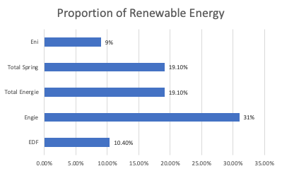
Renewable Energy
Methodology:
Assumptions: Standard households consumption
Characteristics: renewable energy proportion
Method: Comparison of renewable energy proportion of top 5 energy suppliers in France
Why renewable energy benchmark:
Important factor in consumer decision-making
Save consumptions for customers
Environmentally friendly
Source:
https://www.edf.fr/en/the-edf-group/producing-a-climate-friendly-energy#:~:text=In%20France%2C%20the%20electricity%20produced,nuclear%20power%20and%20renewable%20energies.
https://www.engie.com/sites/default/files/assets/documents/2021-09/ENGIE-ChiffresCle2021-EN-WEB_0.pdf
https://www.iddri.org/en/publications-and-events/blog-post/how-accelerate-renewable-energies-france-challenge-territorial#:~:text=At%20the%20European%20level%2C%20France,is%20greatest%20for%20renewable%20heat.
https://www.total-spring.fr/
https://www.eni.com/en-IT/eni-worldwide/eurasia/france.html

